Slide 1
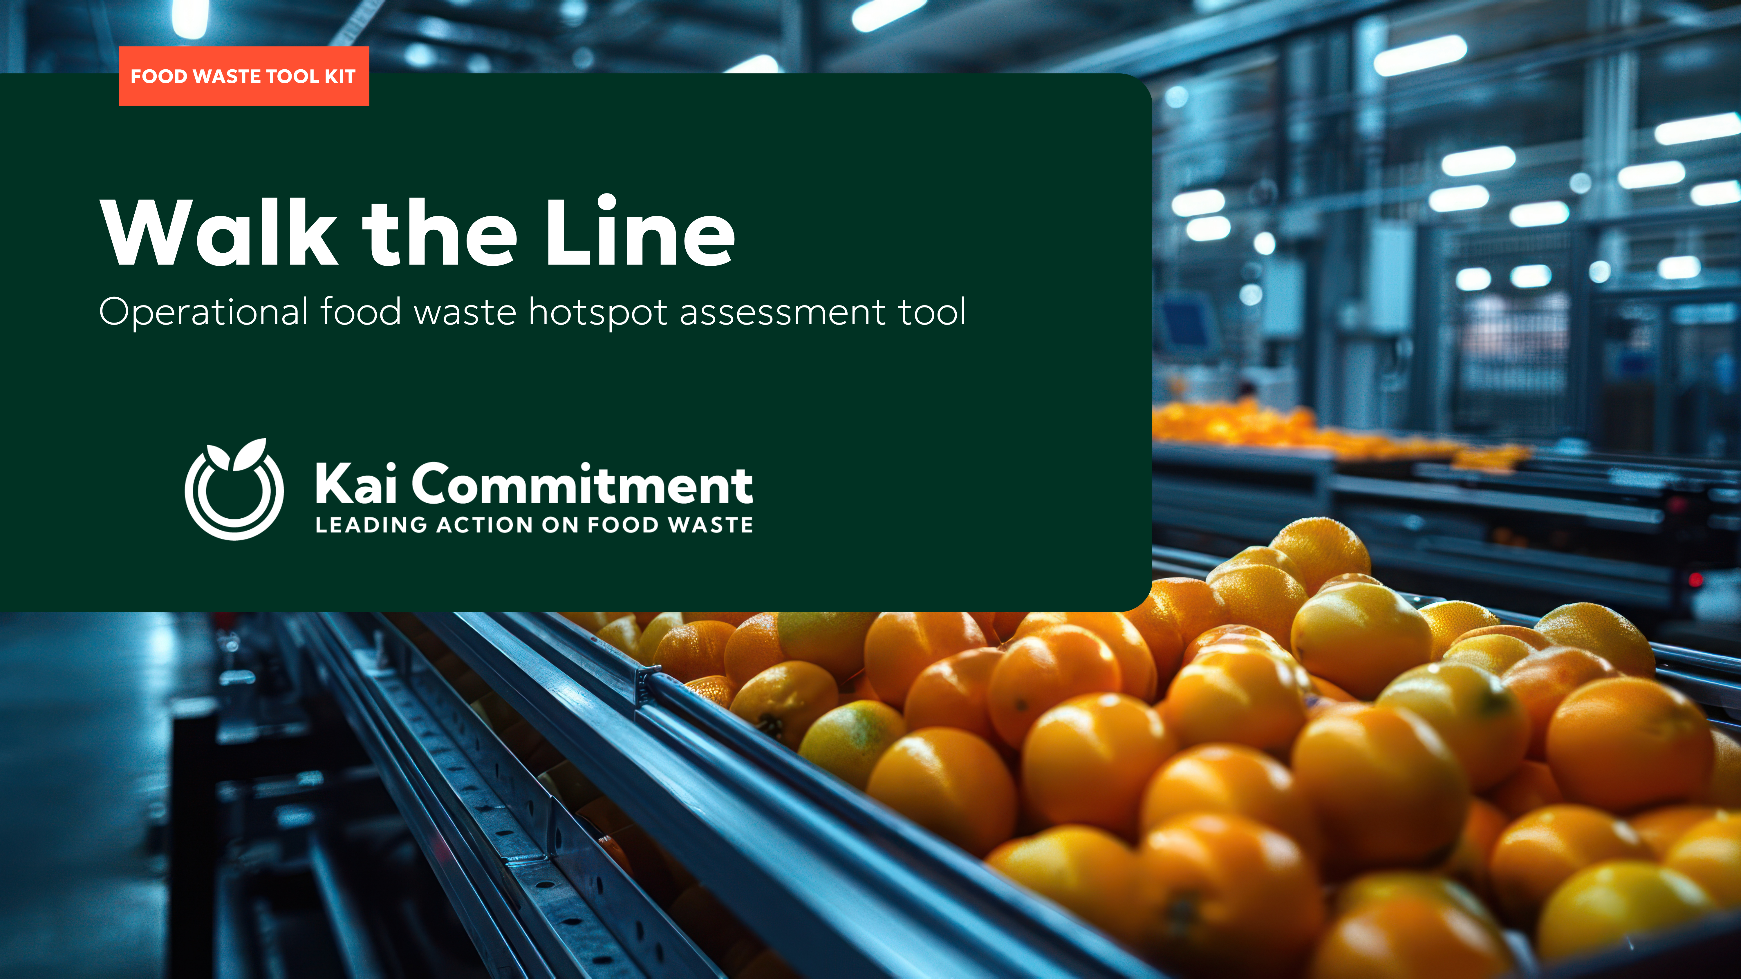

Slide 2
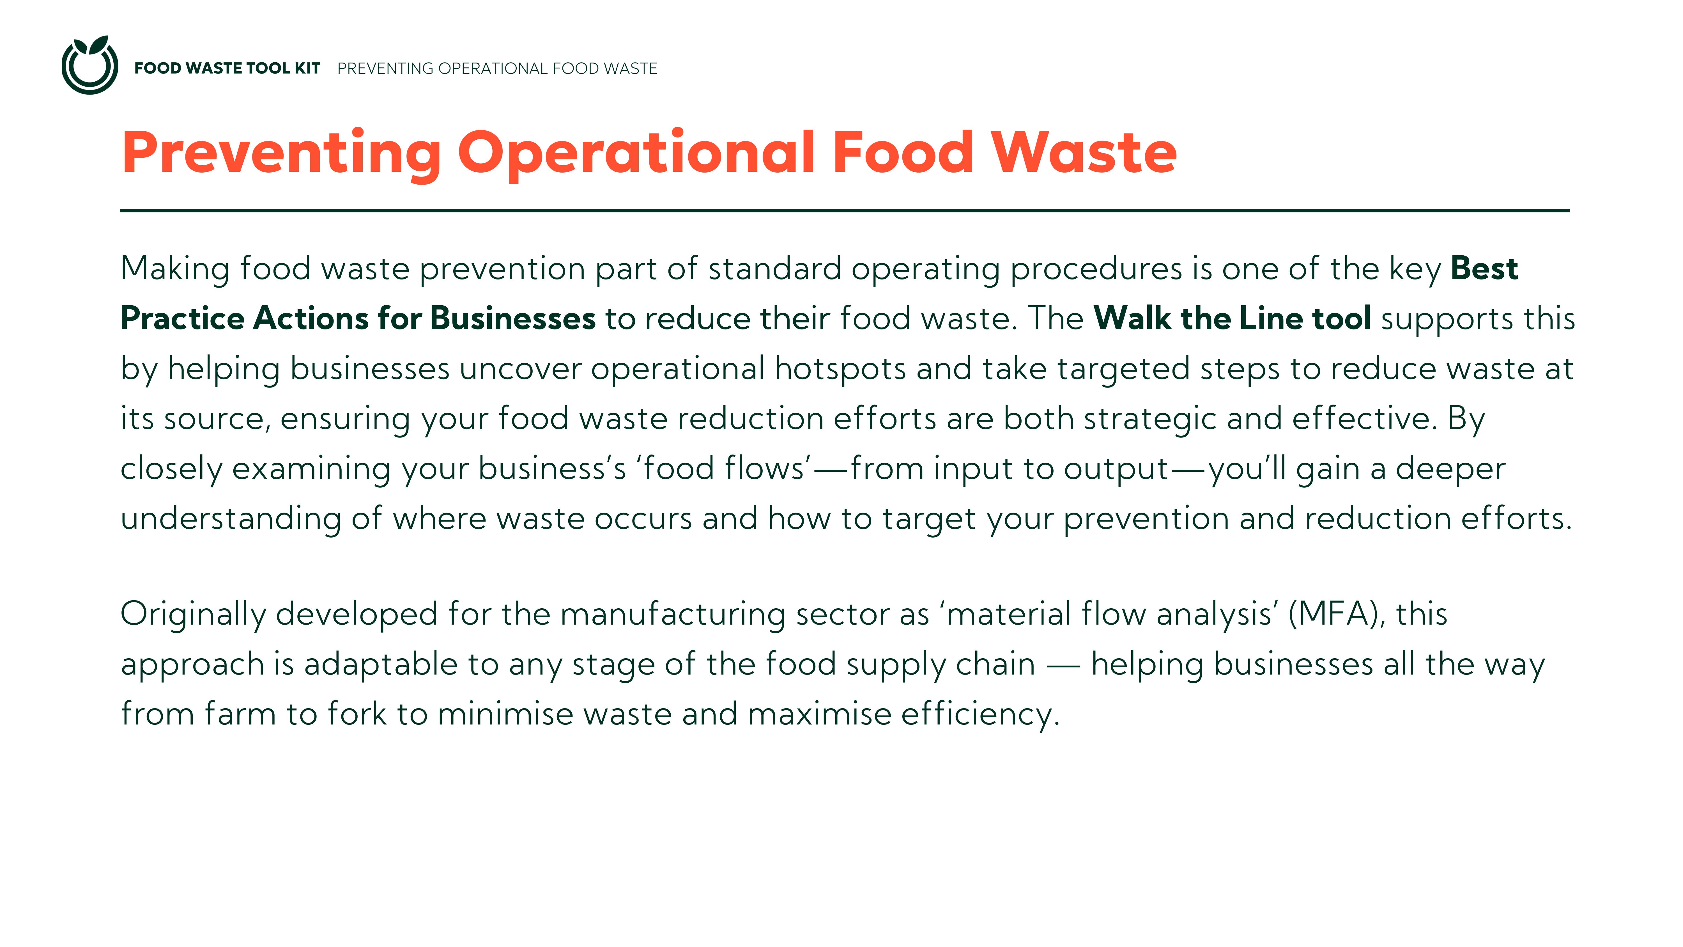

Slide 4
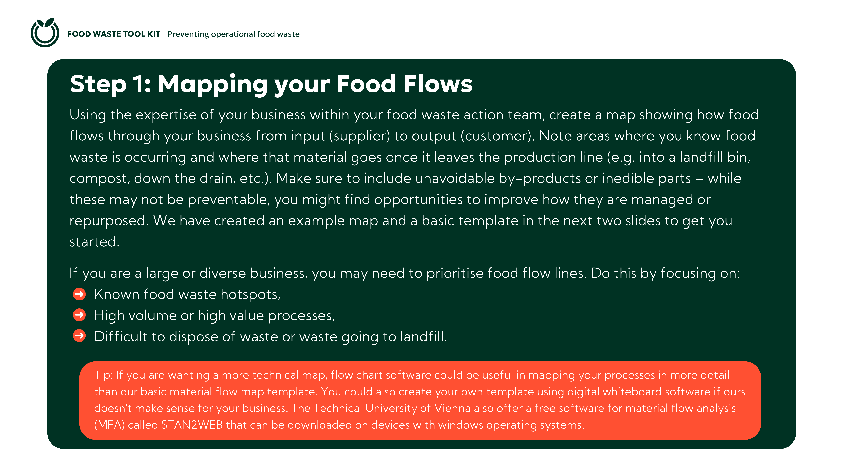

Slide 5
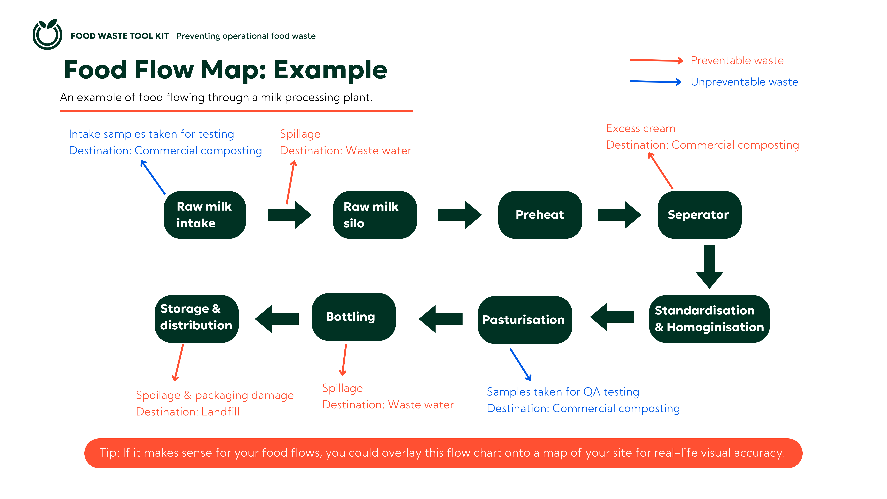

Slide 6

Food Flow Map: Template
[Rename stages and waste streams to fit the material flows of your business and move the waste stream arrows to the appropriate spot in the material flow. Add or delete stages and waste streams as needed. Tip: If it makes sense for your food flows, you could overlay this flow chart onto a map of your site for real-life visual accuracy.]
[waste stream],
Destination:
[waste stream],
Destination:
[Stage 1]
[Stage 2]
[Stage 3]
[waste stream],
Destination:
[waste stream],
Destination:
[Stage 6]
[Stage 5]
[Stage 4]
Preventable waste
Unavoidable waste

Slide 7
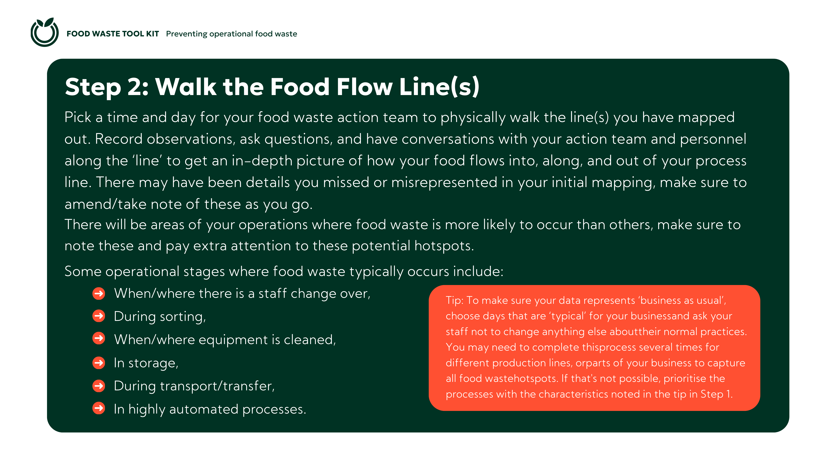

Slide 8
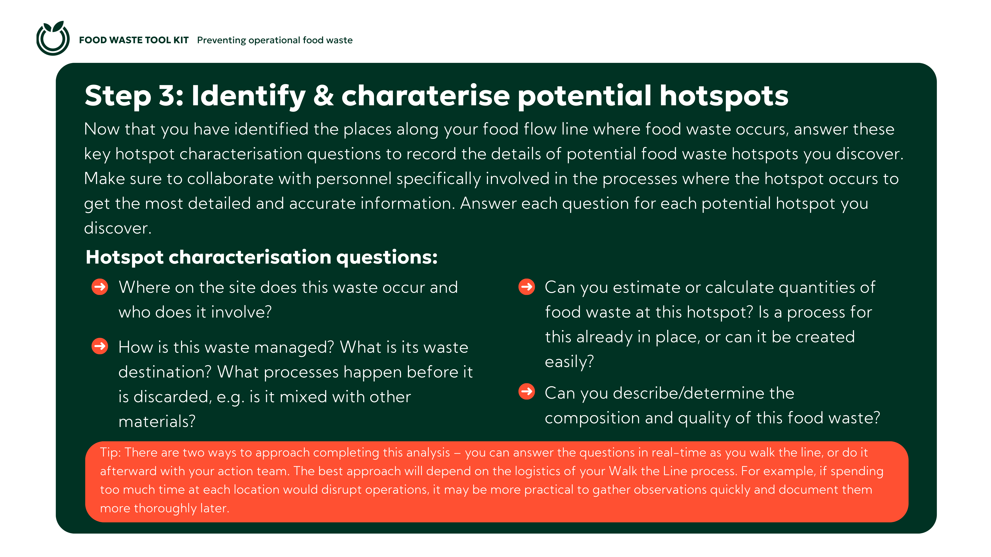

Slide 9
